Slide 1





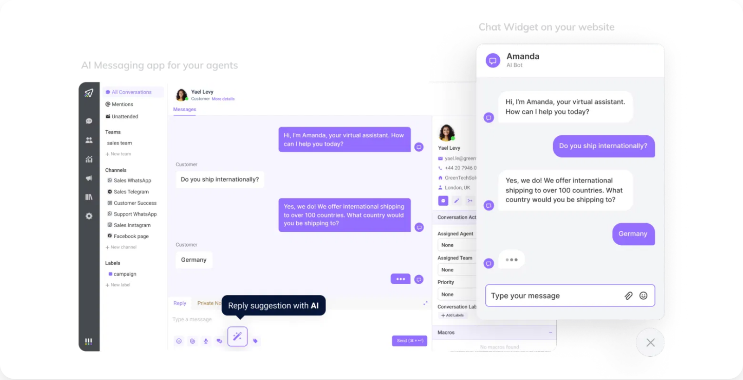

AI Customer Service Assistant: Transforming Business Communication
The Problem
Measurable Impact
Businesses face overwhelming volumes of repetitive customer inquiries, resulting in:
50% Reduction in Response Time
Instant answers to common questions, eliminating wait times
Slow response times
30% Cost Reduction
Inconsistent information
Lower operational expenses by automating routine inquiries
High operational costs
Customer service team burnout
Improved Customer Satisfaction
Customer frustration
24/7 support availability and consistent responses
Enhanced Agent Productivity
Human agents focus on complex issues requiring empathy
The AI Solution
Our AI Customer Service Assistant automates routine inquiries through:
User Interaction
Automated FAQ responses
Customers engage through chat interfaces on websites or messaging apps with seamless human handoff when needed.
Order status tracking
Basic troubleshooting
Lead qualification
Smart escalation to human agents

